Slide 1















PLAYER 1
HIGHSCORE 2500
PLAYER 2
Q1 OVERVIEW
q1 deliverables : Setting the Stage

Slide 2













01
07
12
AGENDA
TOPICS COVERED
Q1 Goals
PLatform-specific Deliverables
Game Development Project
Metrics, Lessons Learned, and Future Directions

Slide 3



01
07
12
Q1 GOALS
Recap of overall objectives:
Expand brand presence and engagement across multiple digital platforms
Drive audience growth and interaction through diverse content strategies
Advance the development of our game project while maintaining code integrity and collaboration
key areas of focus:
Content Creation and Game Development
Back to
Agenda Page

Slide 4











Back to Agenda Page
CONTENT CREATION STRATEGY
Overview of content creation goals for Q1:
Enhance brand visibility and engagement on various platforms including Pinterest, Instagram, TikTok, YouTube, Threads, and Twitch
Develop tailored content strategies for each platform to maximize audience reach and interaction

Slide 5
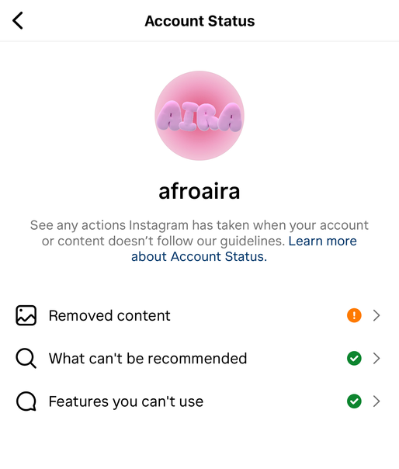
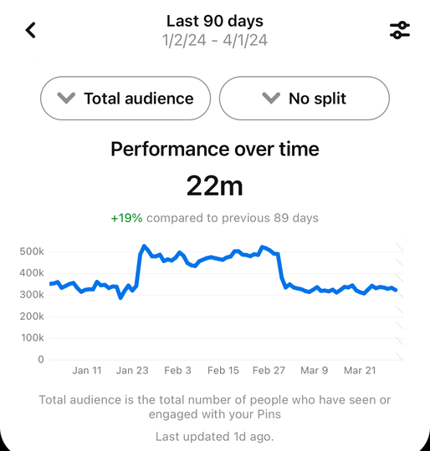
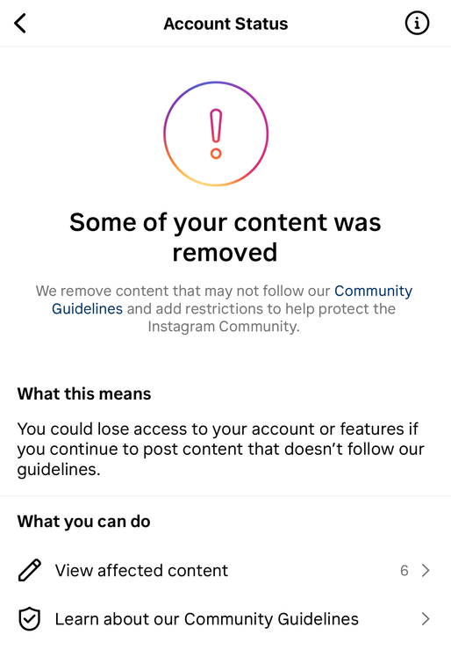
Key Results (OKRs) for Instagram
Increase follower count by +2336
Achieve a 30% increase in engagement rate
+10% inscrease in subscribers engament
C D 1: PINTEREST && INSTAGRAM
Key Results (OKRs) for Pinterest
Increase follower count by 34%
Achieve a 40% increase in engagement rate
Achievements and Challenges:
Account status: Branded content, paid Partnerships + monetization Eligible
shop unavailable on instgarm
Back to Agenda Page

Slide 6

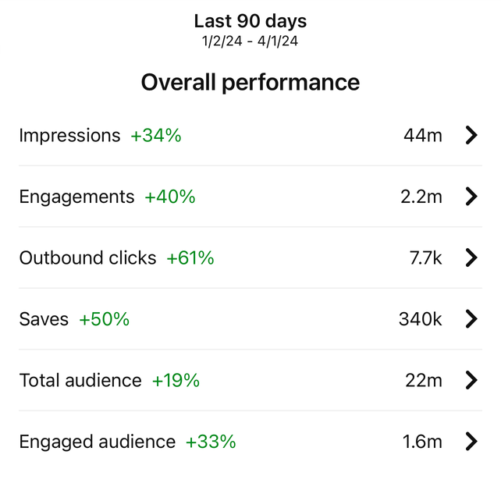
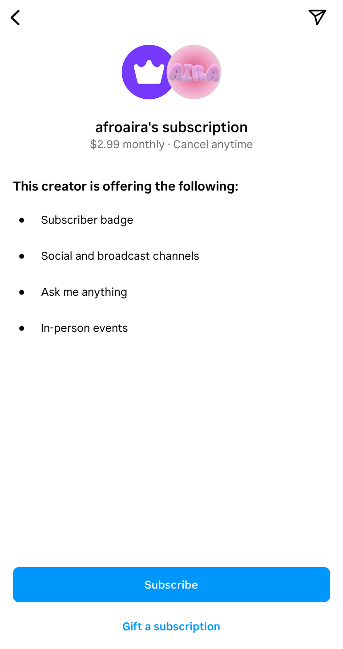
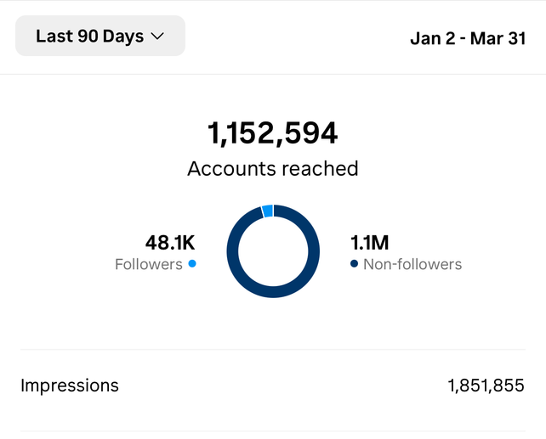
PLAYER 1
Analyics
Back to Agenda Page

Slide 7
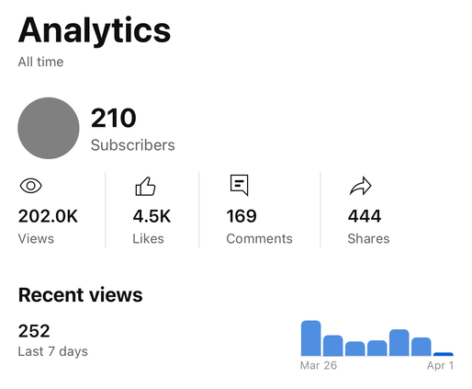
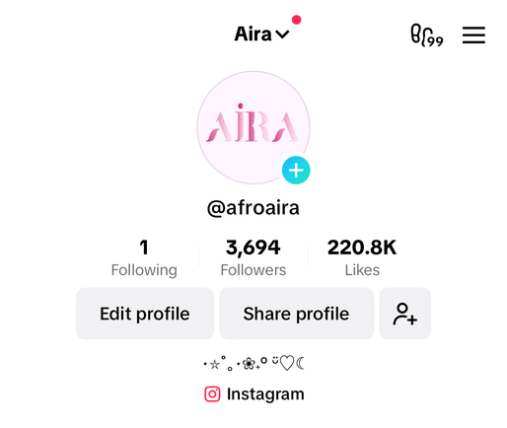
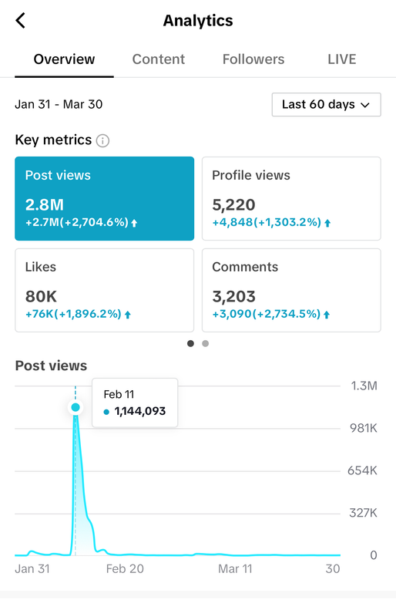
Key Results (OKRs) for Youtube
reached 200,000+ views
+210 subs
C D 1:
TIKTOK
&&
YOUTUBE
Key Results (OKRs) for TikTok
Increase follower count by 10%
Achieve a 200+likes
3 viral videos
Achievements and Challenges:
increased subscribers
tiktok followers slightly below target
Back to Agenda Page

Slide 8
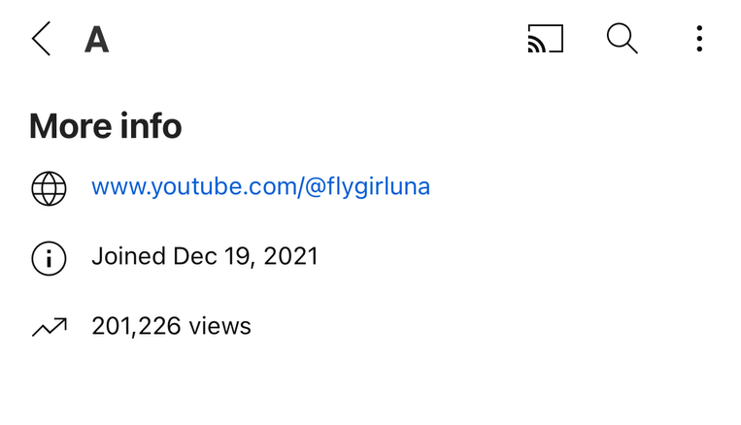

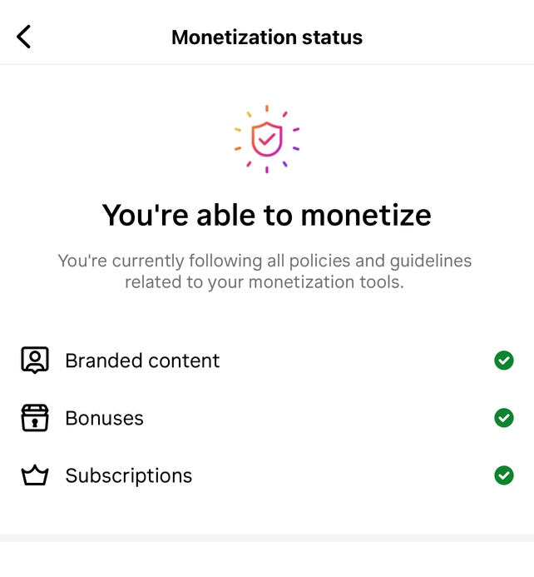
PLAYER 1
Analyics
Back to Agenda Page

Slide 9
Back to Agenda Page
01
07
12
on my thanos ahh era (7 platforms)
7 OUT OF 7
happiness scale
100%
average montly views
20 MILLION

Slide 10

GAME DEVELOPMENT: GITHUB REPOSITORY MANAGEMENT
Task Description | OKRs | Progress Update | Additional Notes | Challenges
Branching and merging code changes | Maintain commit frequency of 5 per Q | Commit frequency: 1 per Q | Improved problem solving skills | Time constraints
Code reviews and feedback sessions | Achieve code coverage of 80% in unit tests | Code coverage: 0% (slightly below target) | Increased emphasis on automated testing | Limited resources
Continuous integration and deployment | Automate build and deployment processes | Implementing CI/CD pipeline for automated builds | Streamlined deployment process (A BITCH CAN WISH) | Technical issues
Documentation and knowledge sharing | Maintain up-to-date documentation of codebase | Updated README and documentation for new features | code documentation | Resource allocation
Back to Agenda Page

Slide 11

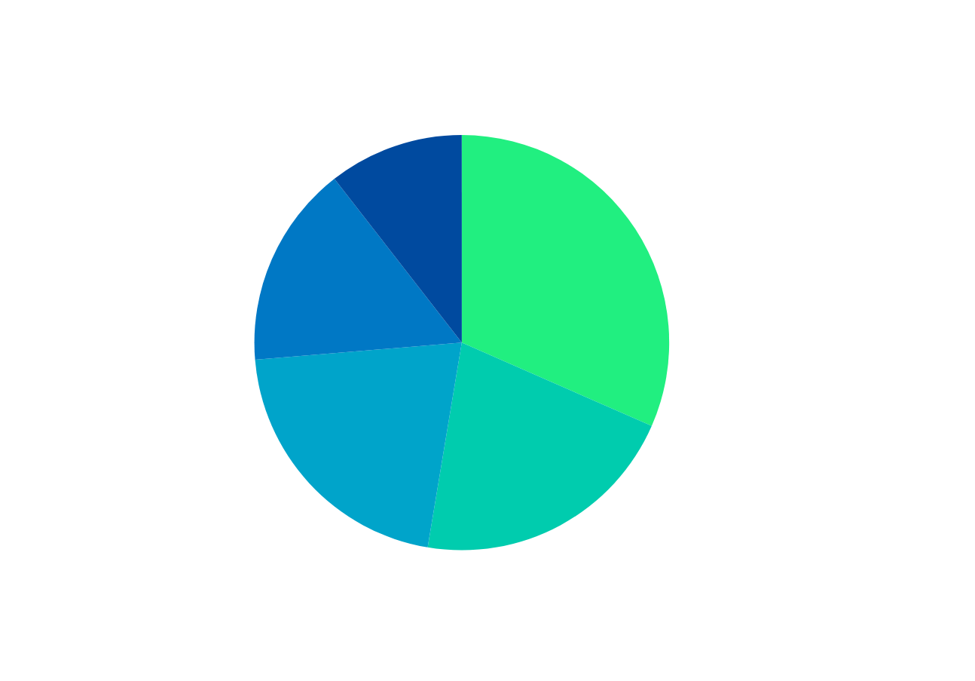
HIGHSCORE 2500
PLAYER 2
METRICS AND KPIS
the key metrics and performance indicators (KPIs) that we are tracking for both our content creation and game development projects
Back to Agenda Page

Slide 12
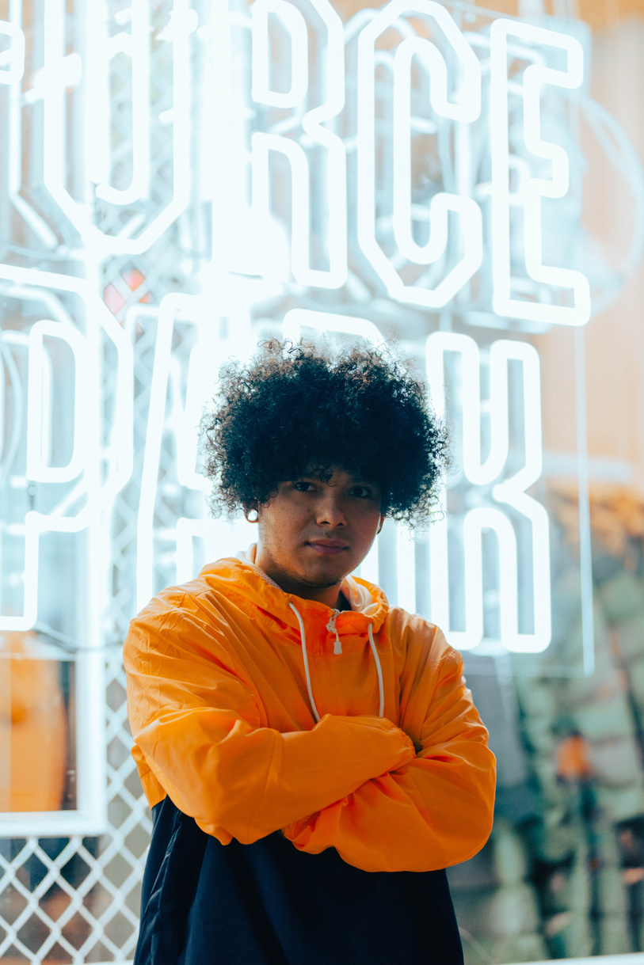



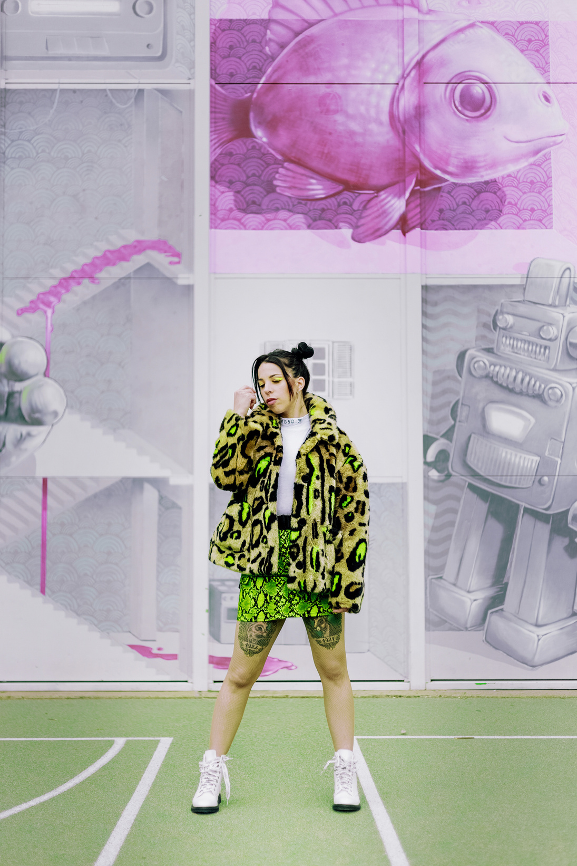

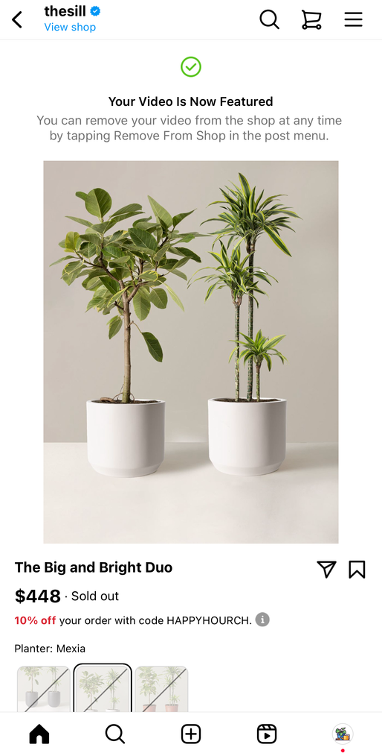
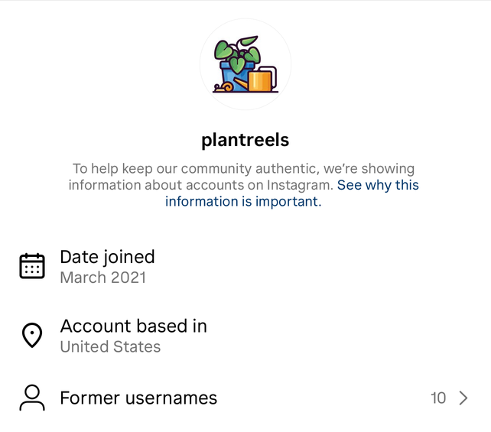
BRANDING UPDATES + SPONOSORSHIPS
increased impact
New @airareels
Growing community! @plantreels
@plantreels was featured 4 @thesill
free wallpapers for @plantreels subs
Airareels Launch
got into 10+ PR lists

Slide 13
pushing boundaries
Vibrating High
expansion
Lessons Learned and Future Directions
innovation
Consumer Behavior
MARKET
TRENDS
"In business, knowing when to vibrate high or low is crucial to sustaining success." - me
Risk Mitigation
Analysis
evolution
vibe low
Agility
speed
reflection

Slide 14

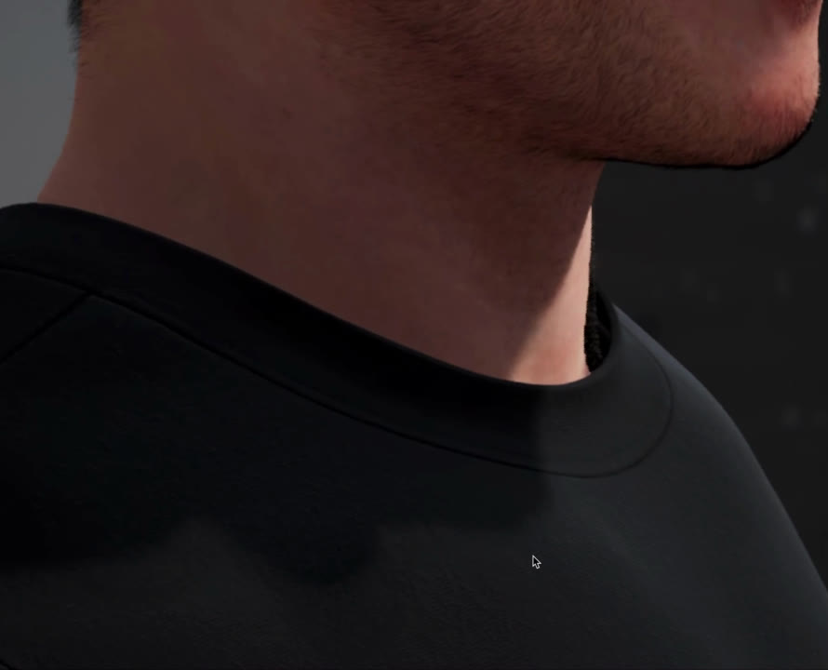


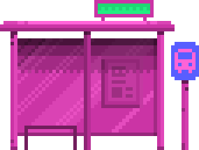


THANK YOU!
DM @NIONWAR IF YOU WANT $

Slide 15
RESOURCE
Page
GITHUB
@PLANTREELS
@AFROAIRA
GAME BETA
PERSONL
EMAIL
UNREAL
>>>>

